Slide 1
CS3241 Lab 1 Doodle

Slide 2
Setting up OpenGL (VS2008)
In this module we will use VS2008 or VS2010 for assignments
Put glut.dll and glut32.dll in “C:\windows\system” and “C:\windows\sytem32” respectively
Put glut.h in “C:\Program Files\Microsoft Visual Studio 8.0\VC\include\GL”
Put glut.lib and glut32.lib in “C:\Program Files\Microsoft Visual Studio 8.0\VC\lib”

Slide 3
Opening Lab 1
Download the .zip file from IVLE workbin
Unzip it into a directory
You can first play around with sample.exe
Follow the instruction to open the solution file
Click “Build”

Slide 4
Drawing a Disk
Look for the function display() in main.cpp
Draw a disk with radius 1 and center at (0,0)
int i;
glColor3f(0,1,0);
glBegin(GL_POLYGON);
for(i=0;i<20;i++)
glVertex2f(sin(2.0*M_PI*i/20.0),
cos(2.0*M_PI*i/20.0));
glEnd();

Slide 5
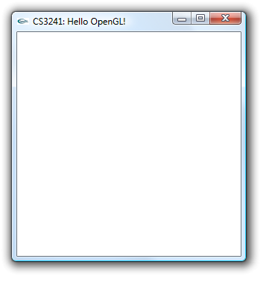
glOrtho
(0,+1)
(0,+10)
?
The disk is supposed to have radius 1. Why is it so small?
The function:
glOrtho(-10, 10, -10, 10, -10, 10)
Changed the dimensions into 10 x 10 x 10 (x, y and z)
(-1,0)
(+1,0)
(-10,0)
(+10,0)
(0,-1)
(0,-10)

Slide 6
Drawing a Circle
Try changing GL_POLYGON into
GL_LINE_STRIP or GL_LINE_LOOP
Draw a disk with radius 1 and center at (0,0)
int i;
glColor3f(0,1,0);
glBegin(GL_LINE_STRIP);
for(i=0;i<20;i++)
glVertex2f(sin(2.0*M_PI*i/20.0),
cos(2.0*M_PI*i/20.0));
glEnd();

Slide 7
Function drawArc()
void drawArc(double cx, double cy, float r,
int startDeg, int endDeg)
{
int i;
glColor3f(0,0,0);
glBegin(GL_LINE_STRIP);
for(i=startDeg;i<=endDeg;i++)
glVertex2f(cx+r*sin(2.0*M_PI*i/360.0),
cy+r*cos(2.0*M_PI*i/360.0));
glEnd();
}

Slide 8
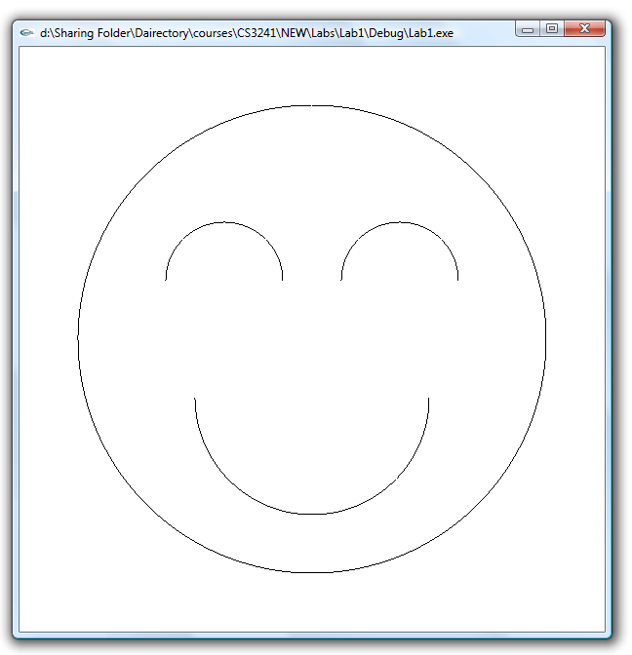
Try drawing this
drawArc(0,0,8,0,360);
drawArc(3,2,2,-90,90);
drawArc(-3,2,2,-90,90);
drawArc(0,-2,4,90,270);

Slide 9
About HW1
Make sure you did these when you submit
Able to be compiled by the lab machines!!!
Complied in RELEASE mode
All the function keys (Q,E, etc.) still work probably for your work
“Clean” the solution
You can delete the .pcb file after cleaning to reduce the file size
Write a text file include your work’s information
(see the lab instruction)
Zip all your files up, rename it into your student number + “.zip” and submit it up to IVLE

